Slide 1

Has the Women’s Super League (WSL) growth strategy been working? An analysis of the 2020/21 – 2023/24 seasons
By Uyi Erhabor

Slide 2
Executive Summary
Quality of the league in terms of average goals and average expected goals (xG) per game has remained consistent
Analysis of data available reveals no definitive trend of competitive balance in the WSL
Total xG and Total goals have been key drivers of attendances

Slide 3
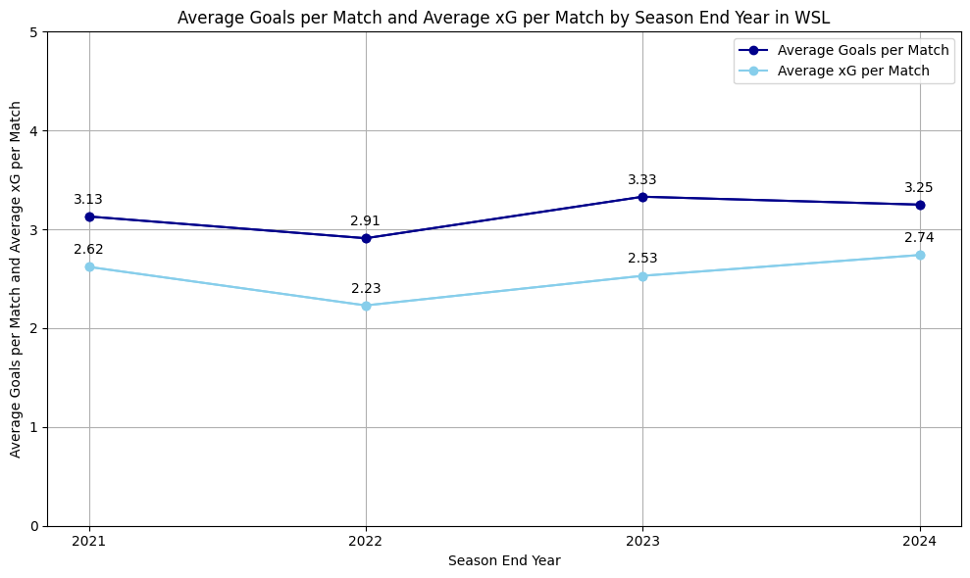
Minimal changes in average xG and average goals per match
Range in average goals per match (0.42)
Range in average xG per match (0.51)

Slide 4
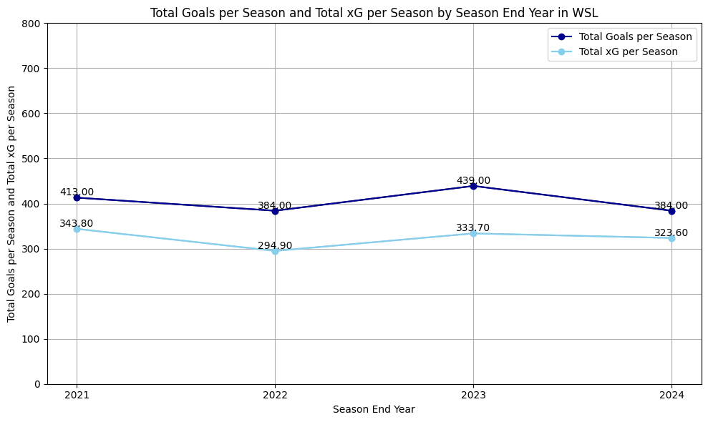
Noticeable variation in total goals and total xG
Range in total goals (55)
Range in total xG (48.90)

Slide 5
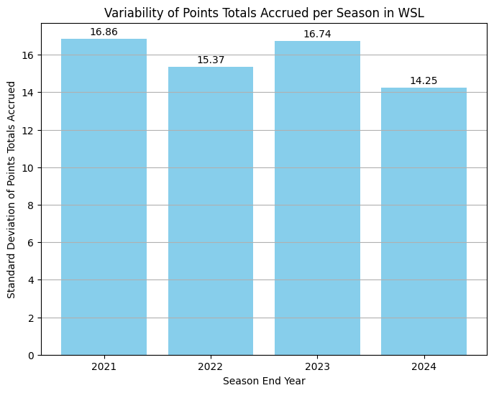
Is the WSL establishing its level of competitive balance ?

Slide 6
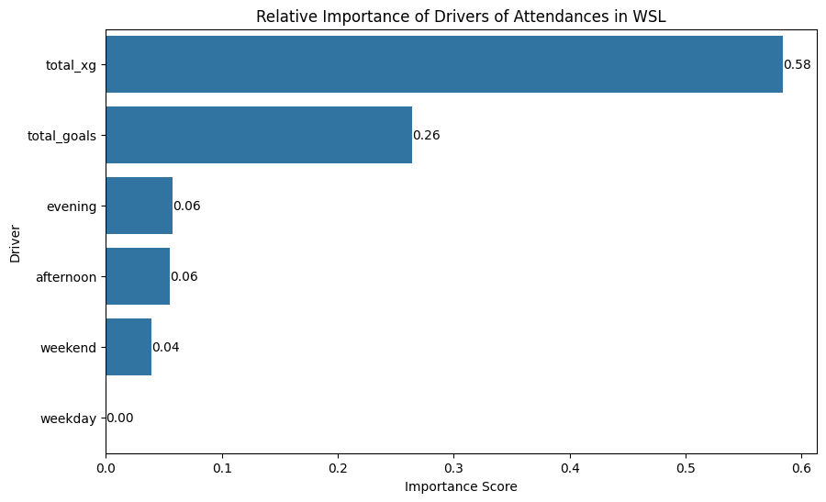
Key drivers of Attendance: Goals over everything?

Slide 7
Key findings
Quality of the league in terms of average goals and average expected goals (xG) per game has remained consistent
Analysis of data available reveals no definitive trend of competitive balance in the WSL
Total xG and Total goals have been key drivers of attendances

